Slide 1
INTRODUCTION TO DATA SCIENCE
PRESENTED BY:
ABHIJEET MURTHY – PES1201700139
ATHARV VERMA-PES1201700026
PRIYANSHU GUPTA – PES1201700110

Slide 2
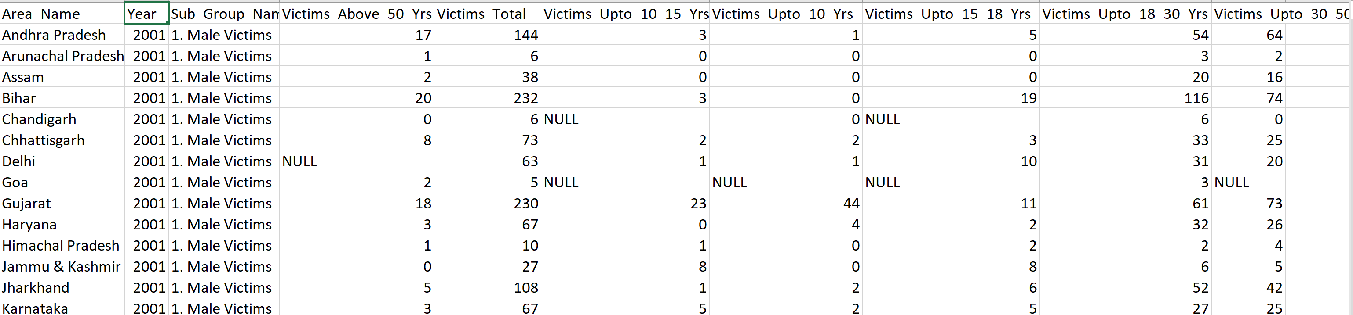
DATA SET CHOSEN
MURDER VICTIMS IN ALL THE STATES OF INDIA FROM THE YEAR 2001 TO 2010:
THIS DATA SET REPRESENTS THE NUMBER OF MALE & FEMALE VICTIMS WHO HAVE BEEN VICTIMS OF THE CRIME FROM THE YEAR 2001 TO 2010.
THIS DATA SET WAS RETRIEVED FROM kaggle.com .
WE HAVE ANALYSED THE DATASET AND THE RESULTS OF OUR VISUALIZATION AND HYPOTHESIS ARE AS FOLLOWS.

Slide 3
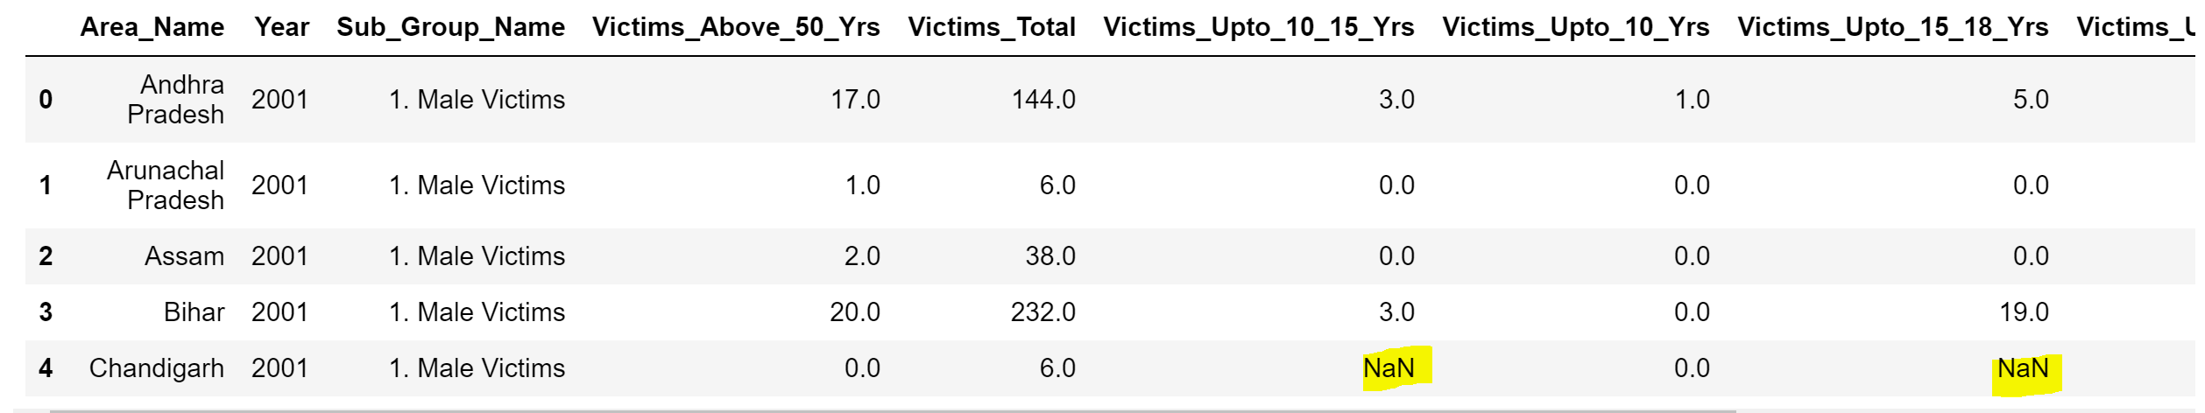
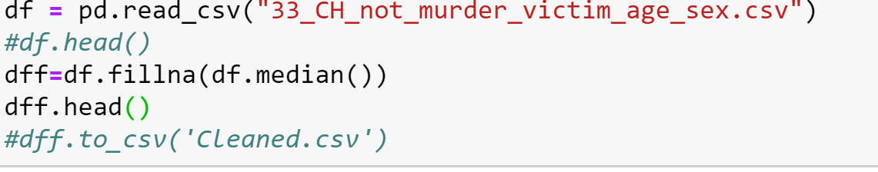
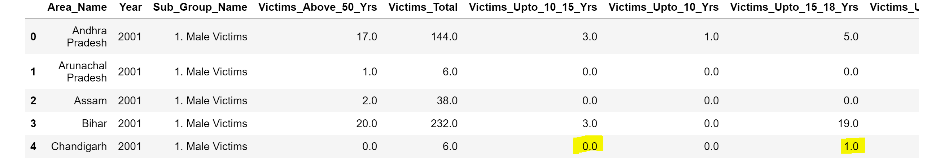
DATA CLEANING
DATASET BEFORE CLEANING :
CODE SNIPPET:
DATASET AFTER CLEANING :

Slide 4
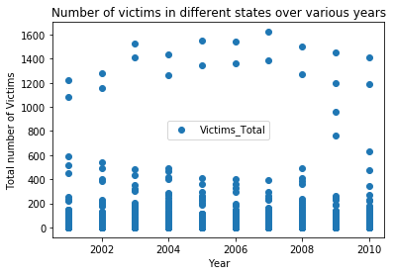
SCATTER PLOT

Slide 5
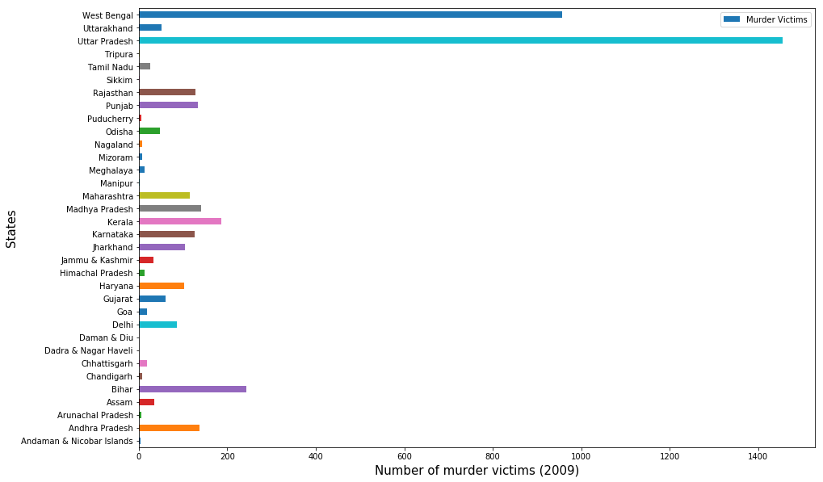
A COMPARATIVE CASE STUDY

Slide 6
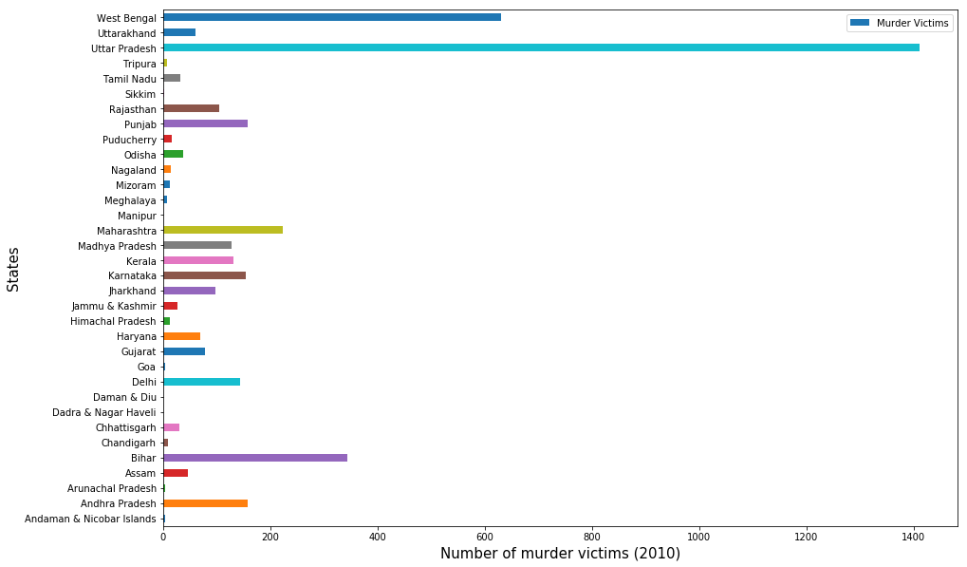

Slide 7
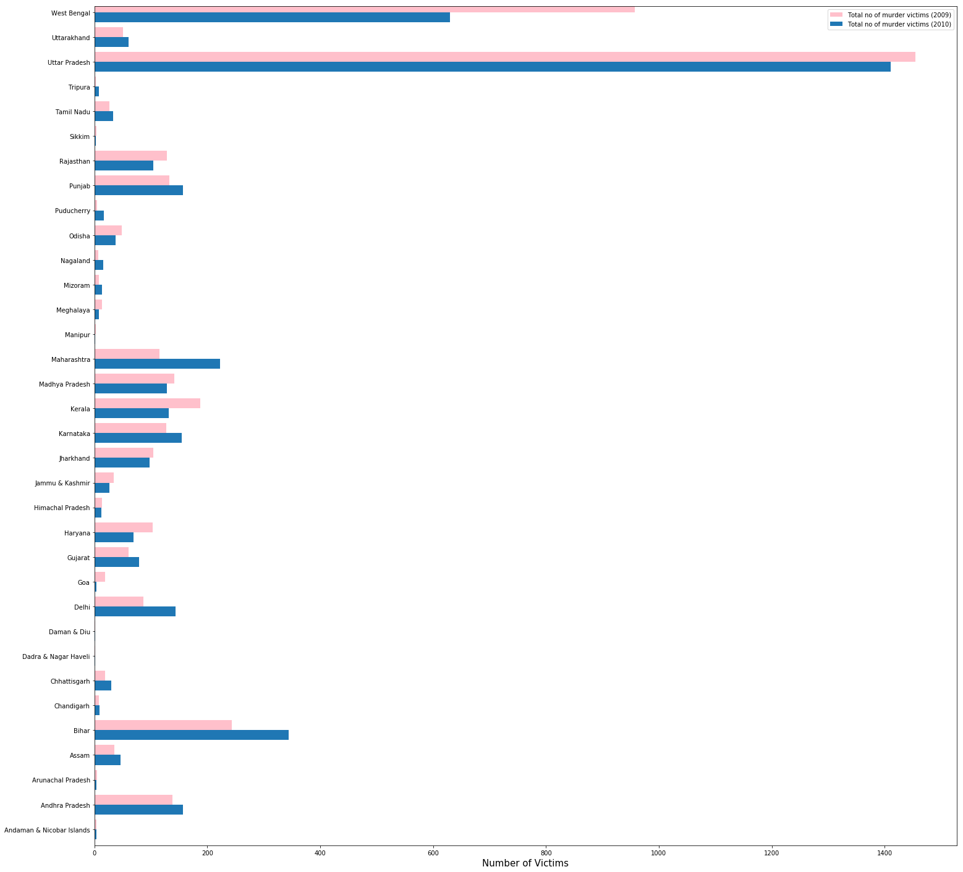
THIS IS THE GRAPH COMPARING THE CRIME RATES OF EVERY STATE IN INDIA FOR THE YEAR 2009 AND 2010.
CLEARLY THE TREND OBSERVED IS NOT UNIFORM SO WE CANNOT CONCLUDE WHICH YEAR WITNESSED MORE CRIMES AS THE NUMBER OF VICTIMS HAVE INCREASED FOR A FEW STATES AND DECREASED FOR A FEW.

Slide 8
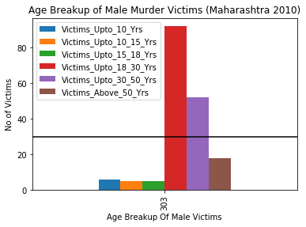
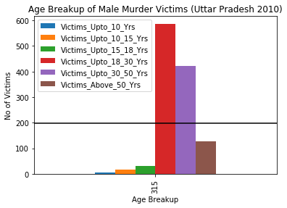
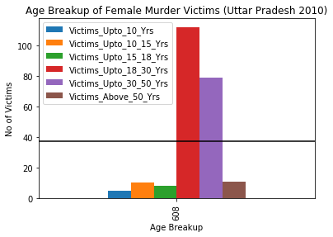
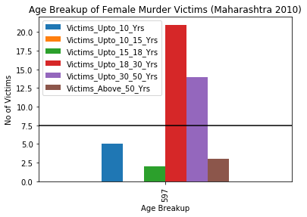

Slide 9
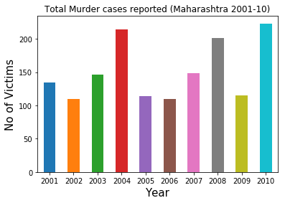
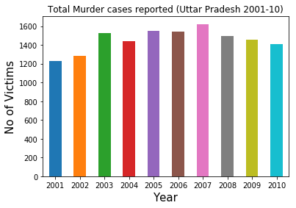
THE GRAPHS ABOVE REPRESENT TOTAL NUMBER OF MURDER CASES REPORTED IN THE STATES OF MAHARASHTRA AND UTTAR PRADESH OVER THE COURSE OF
10 YEARS.
IT IS IMPORTANT TO NOTE THAT THE GRAPHS MIGHT LOOK SIMILAR BUT THEY DIFFER GREATLY IN TERMS OF THEIR SCALE OF NUMBER OF SUCH CASES AND THUS IS NOT A PROPER METHOD TO COMPARE CRIME RATES IN BOTH THE STATES.

Slide 10
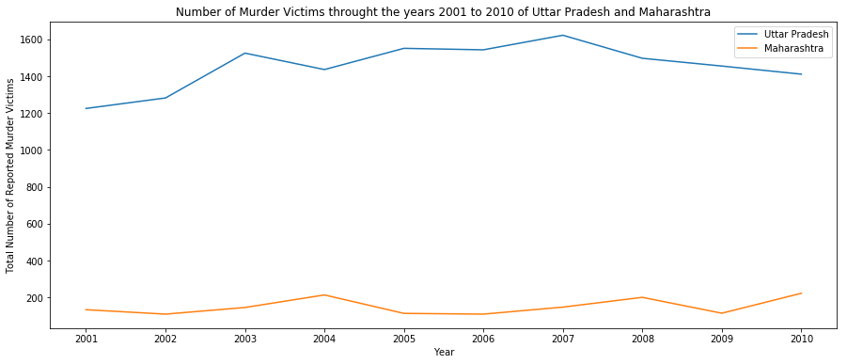
THE PROBLEM ENCOUNTERED BEFORE CAN BE PROPERLY HANDLED BY USING
A COMPARATIVE LINE GRAPH
WE CAN CLEARLY CONCLUDE THAT THE CRIME RATES IN UTTAR PRADESH ARE MUCH
GRATER THAN THAT OF MAHARASHTRA.

Slide 11
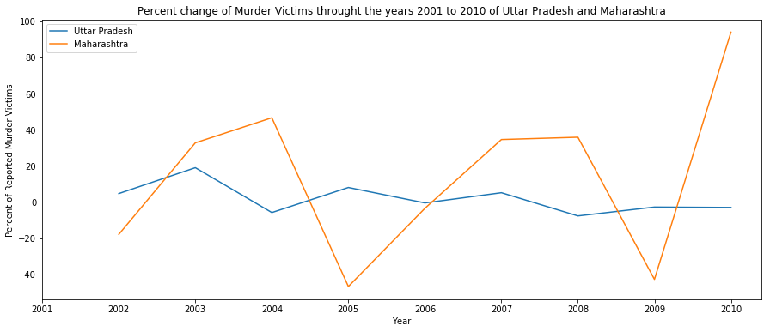
THIS GRAPH REPRESENTS THE PERCENT CHANGE IN THE CRIME RATES IN THE STATES OF MAHARASHTRA AND UTTAR PRADESH OVER THE COURSE OF 10 YEARS (2001 TO 2010).

Slide 12
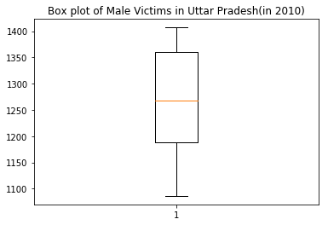
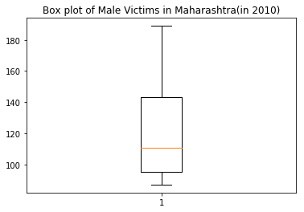
HYPOTHESIS TESTING
(FOR MALE VICTIMS)
SINCE THE BOX PLOT DOES NOT CONTAIN ANY OUTLIERS THEREFORE THIS IS A NORMAL DISTRIBUTION AND HENCE THERE IS NO NEED FOR ANY NORMALIZATION TO BE PERFORMED.
THUS HYPOTHESIS TESTING CAN BE CONDUCTED.

Slide 13
NULL HYPOTHESIS(H0): mean=236
ALTERNATE HYPOTHESIS(H1): mean≠236
P value: 0.006455601293868352
SINCE THE OBTAINED P VALUE IS LESS THAN α(0.05), IT CAN BE CONCLUDED THAT THE NULL HYPOTHESIS IS REJECTED AND THAT THE ALTERNATE HYPOTHESIS IS PLAUSIBLE.

Slide 14
NULL HYPOTHESIS(H0): mean=37.7
ALTERNATE HYPOTHESIS(H1): mean≠37.7
P value: 0.012096731639840763
SINCE THE OBTAINED P VALUE IS LESS THAN α(0.05), IT CAN BE CONCLUDED THAT THE NULL HYPOTHESIS IS REJECTED AND THAT THE ALTERNATE HYPOTHESIS IS PLAUSIBLE.

Slide 15
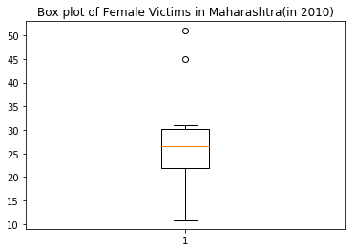
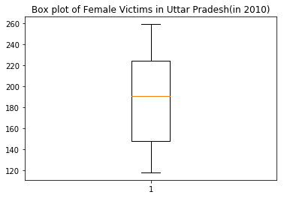
HYPOTHESIS TESTING
(FOR FEMALE VICTIMS)
SINCE THE BOX PLOT CONTAINS OUTLIERS THEREFORE THIS IS A NOT A NORMAL DISTRIBUTION AND THUS HYPOTHESIS TESTING CAN BE CONDUCTED ONLY AFTER NORMALIZATION.

Slide 16
THANK YOU

